Slide 1

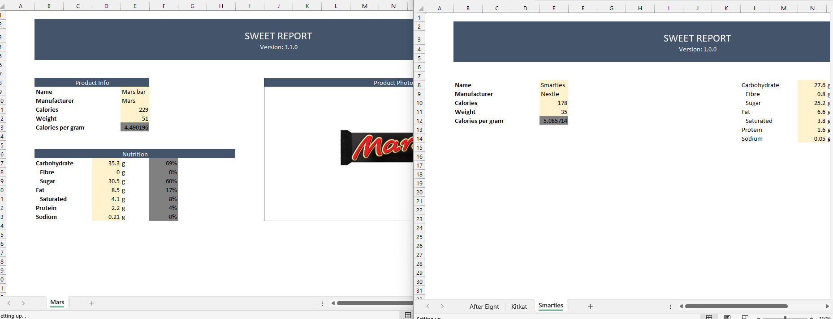
Bulk Structured Spreadsheet Extractor
built with
stdVBA
Different versions of the same report…
Define how to distinguish versions
Define how to extract data from versions
Generated report of data
Supports
Logic, Regex, Find text,
sheet access, OOP member access,
merge aware offset, extensions,
…

Slide 2
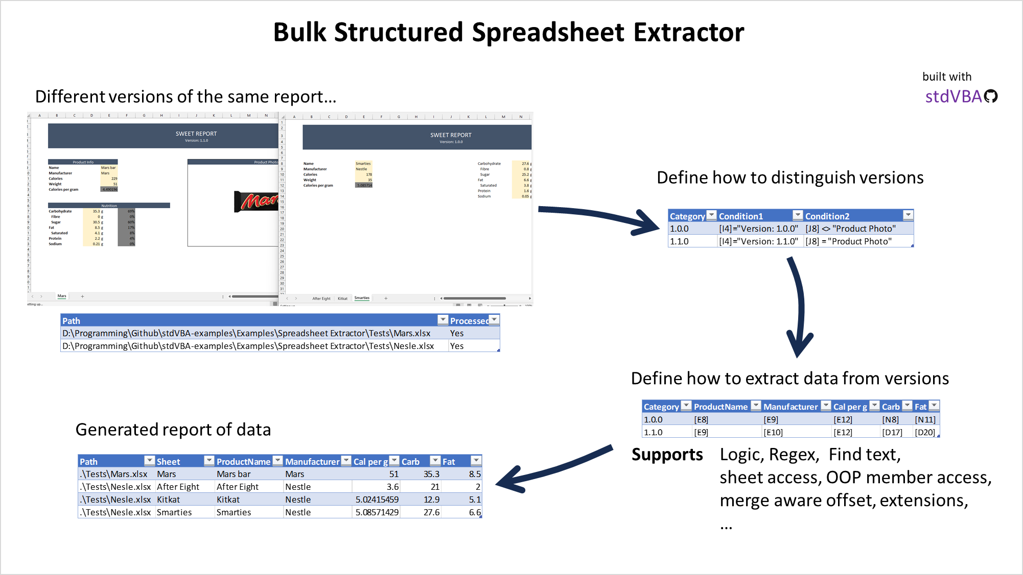

Slide 3
Base Libraries
Spreadsheet Extractor
Of file paths
stdEnumerator
Of results
stdArray
stdCallback
xrExtractor
stdCOM
xrCategories
stdICallable
xrLambdaEx
xrRules
stdLambda
stdRegex
stdPicture

